Slide 1
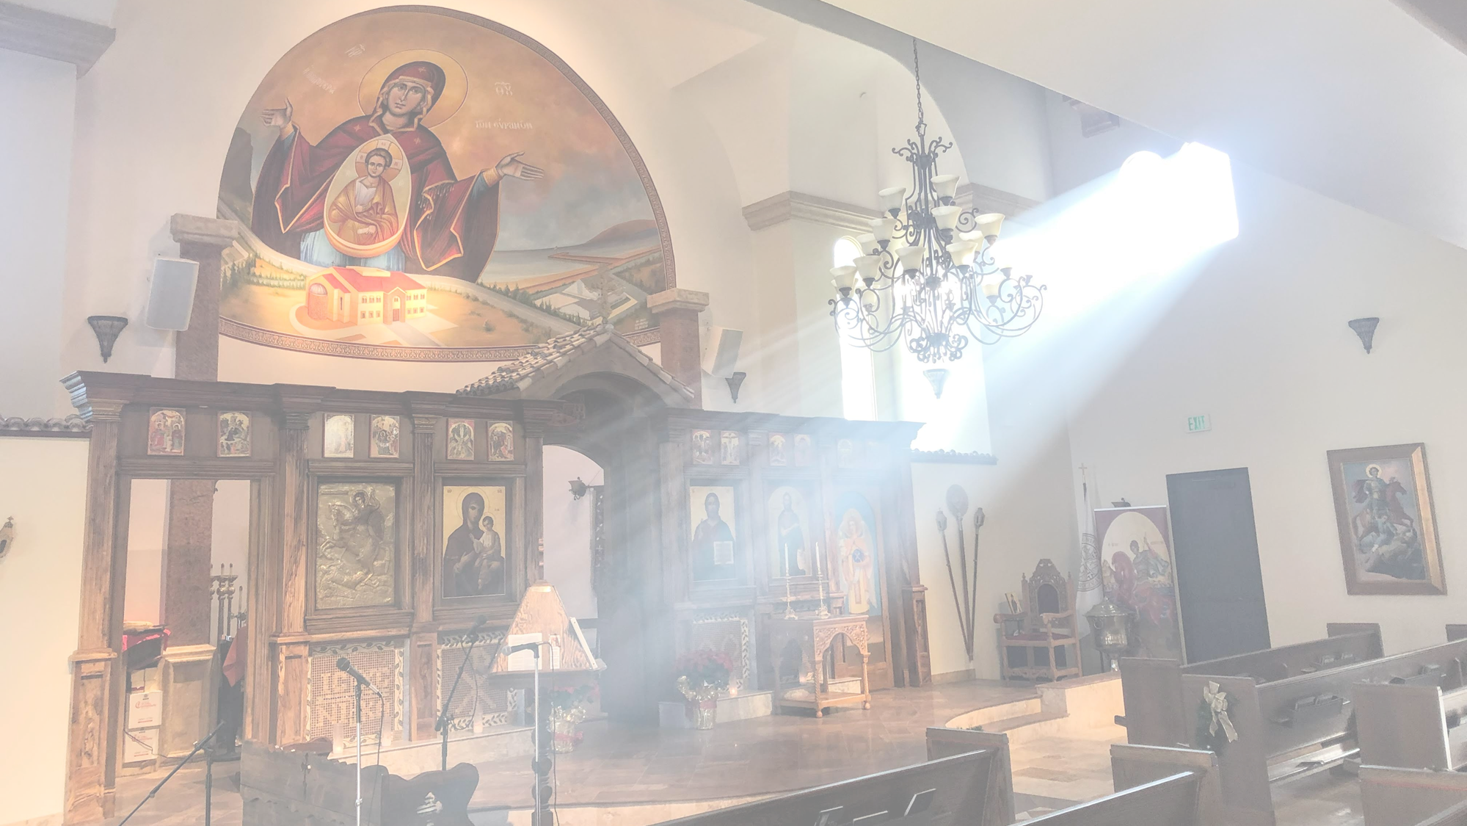
Spiritual Combat:

Slide 2
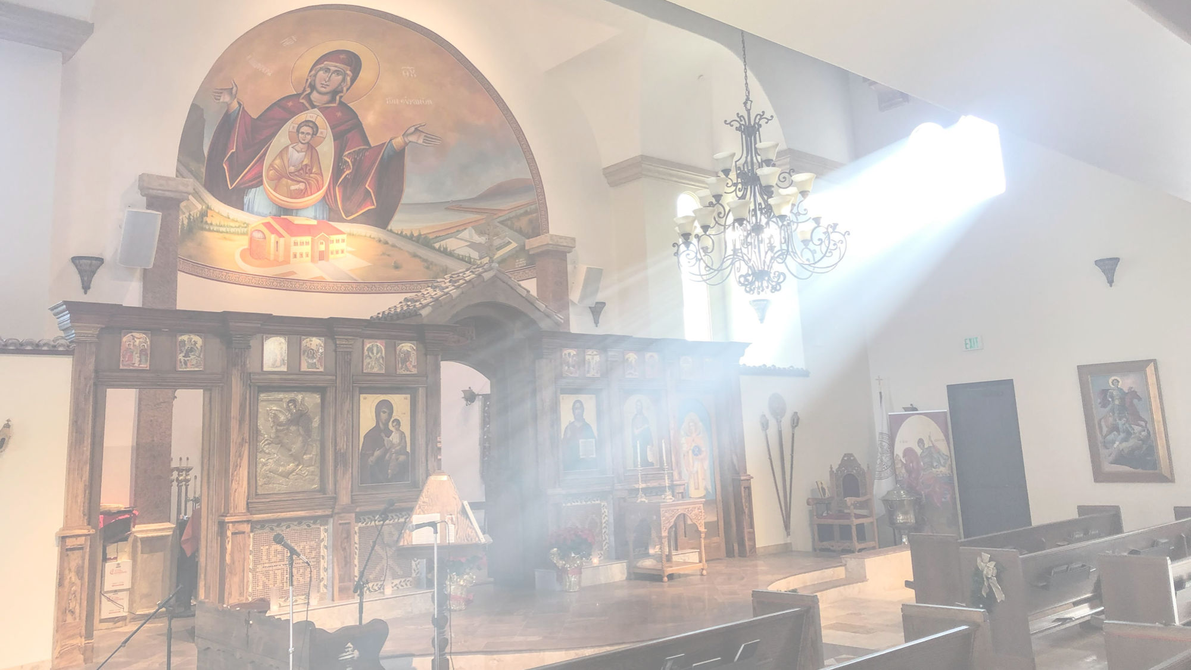
Spiritual Combat:
A Shared Resource of the
East and West to Guide us on the
Path towards Perfection

Slide 3


Slide 4
What is Christian perfection?
To be perfect in all virtues
The virtues, often called the fruits of the Spirit,
Faith
Hope
Knowledge
Wisdom
Honesty
Humility
Obedience
Patience
Courage
Faithfulness
Self-Control
Generosity
Kindness
Gratitude
Contentment
Love -
The greatest virtue of all is love. If we do not love one another, we cannot love God, for God is love.

Slide 5

most perfect thing a man may desire
To be near to God
Dwell in union with Him

Slide 6
How do we get there?
BATTLE
COMBAT
ENTER THE ARENA

Slide 7
What are we fighting?
The enemy?
The Flesh
    The World
        The evil one

Slide 8
To be victorious in this warfare
To receive our crown
NEVER rely on ourselves
ALWAYS trust in GOD
STRIVE without ceasing
CONSTANT state of prayer

Slide 9
NEVER rely on ourselves
PRIDE
Humility!
Notes:
Story about VIN SKULLY- Stan Kasten, his wife, etc.

Slide 10
2. ALWAYS trust in GOD
HE is our Shepherd
Shepherd died for (us) the sheep
Develop relationship

Slide 11
2. ALWAYS trust in GOD
Easy for God to give us victory over enemy
Few or many
New or old
Small or great

Slide 12
2. ALWAYS trust in GOD
Easy for God to give us victory over enemy
Know this!
God has His own time and
order for everything!

Slide 13
2. ALWAYS trust in GOD
Easy for God to give us victory over enemy
God never abandons His warriors

Slide 14
3. Strive without ceasing
In UNSEEN WARFARE all are losers, except the one who never ceases to battle.

Slide 15
3. Strive without ceasing
If our Lord delays in granting full victory over our enemy, it is for our own good:
      Keeps us vigilant
      Humble
      Reminds us of the power of our enemy

Slide 16
3. Strive without ceasing
We live in the arena
Always on the battlefield
      Keeps us vigilant
      Humble
      Remind us of the power of our enemy

Slide 17
3. Strive without ceasing
Always fight
Always be prepared

Slide 18
3. Strive without ceasing
How a warrior for Christ prepares for battle every morning:
Open your eyes and say, “Lord Jesus Christ, Son of God, have mercy on me.”

Slide 19
3. Strive without ceasing
How a warrior for Christ prepares for battle every morning:
Enemy is on your left and ready to attack

Slide 20
3. Strive without ceasing
How a warrior for Christ prepares for battle every morning:
Remind yourself you are in the arena/battlefield

Slide 21
3. Strive without ceasing
How a warrior for Christ prepares for battle every morning:
Be of GOOD CHEER!!
    Realize on your right stands invisibly present our Commander, Jesus Christ, with His Holy Mother, a host of Angels, the Archangel Michael, ready to come to your aid!

Slide 22
3. Strive without ceasing
every morning:
Open your eyes and say, “Lord Jesus Christ, Son of God, have mercy on me.”
Enemy is on your left and ready to attack
Remind yourself you are in the arena/battlefield
Be of GOOD CHEER!!
    Realize on your right stands invisibly present our Commander, Jesus Christ, with His Holy Mother, a host of Angels, the Archangel Michael, ready to come to your aid!

Slide 23
3. Strive without ceasing
every morning:
“His desire to save
you is greater than that of your enemy to
destroy you.”

Slide 24
4. CONSTANT state of prayer
HE is our Shepherd
The Shepherd died for (us) the sheep
Develop relationship

Slide 25
4. CONSTANT state of prayer
Meditate
Set the mind on higher things
Good company
Avoid those that drag you down
Discipline
Avoid laziness and negligence

Slide 26
4. CONSTANT state of prayer
How to avoid negligence
  Avoid idle wandering
  Avoid idle talk

Slide 27
4. CONSTANT state of prayer
Falling prey to negligence causes you to enter the state of inaction . . .
This leads to laziness

Slide 28
4. CONSTANT state of prayer
Negligence leads to laziness
  Permeates all your actions
  Poisons the will and plants aversion and blinds the mind

Slide 29
4. CONSTANT state of prayer
Negligence and laziness
  Is a disease. . . “that destroys the roots of virtuous habits. Just as a worm gradually gnaws at the root of a tree, so negligence, if it persists, destroys the very nerves of spiritual living.”

Slide 30
4. CONSTANT state of prayer
Negligence and laziness
  Do not sit with folded hands putting off the sewing of the festive garments.
  Be prepared to meet the Bridegroom
  Refuse the whispers of “give to me now and give to God tomorrow.”
  No! Spend your life pleasing God in the present hour!

Slide 31
4. CONSTANT state of prayer
Negligence and laziness
  This takes WORK!
  Repentance
  Obedience
  Resolve

Slide 32
4. CONSTANT state of prayer
Employ the FIVE senses to return your being to God
  Sight
  Sound
  Touch
  Smell
  Taste

Slide 33
4. CONSTANT state of prayer
Employ the FIVE senses to return your being to God
  Sight
  Sound
  Touch
  Smell
  Taste
  Develop spiritual
  practices/exercises/WORK

Slide 34
What is Christian perfection?
To be perfect in all virtues
The virtues, often called the fruits of the Spirit,
Faith
Hope
Knowledge
Wisdom
Honesty
Humility
Obedience
Patience
Courage
Faithfulness
Self-Control
Generosity
Kindness
Gratitude
Contentment
Love -
The greatest virtue of all is love. If we do not love one another, we cannot love God, for God is love.

Slide 35
Spiritual Combat:
A Shared Resource of the
East and West to Guide us on the
Path towards Perfection

Slide 37
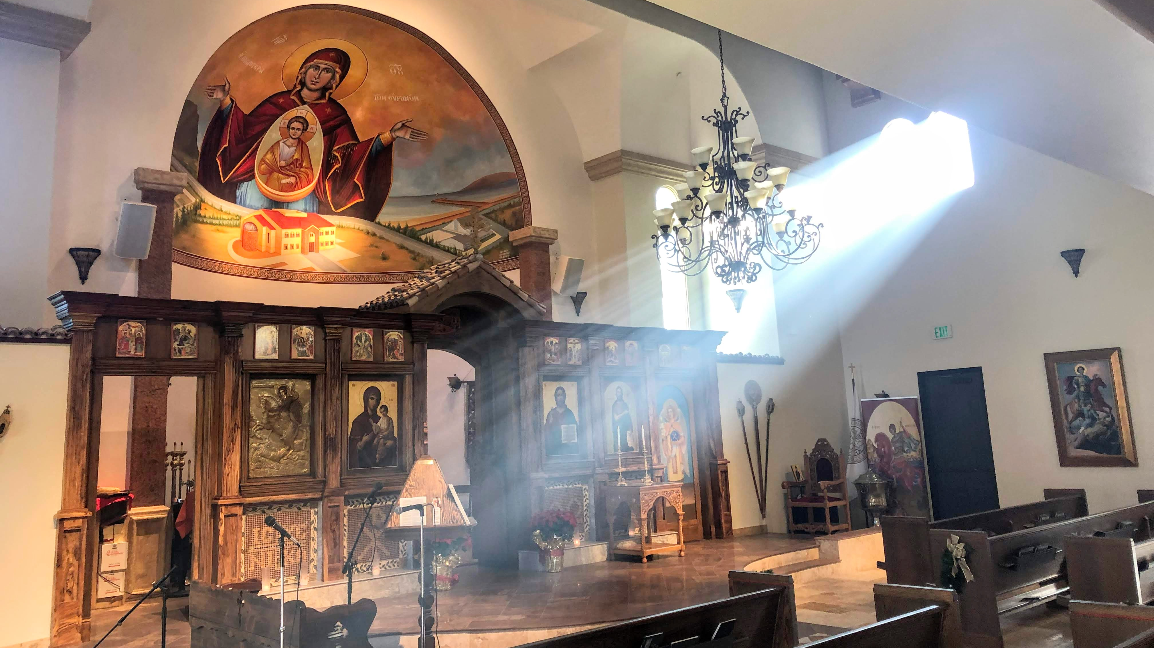
Thank you
Fr. Gary Kyriacou
Parish Priest
St. Demetrios Greek Orthodox Church Camarillo, CA

